Slide 1
Phylum
Echinodermata
(5 Classes) Oh I ACHE!
Asteroids CRashed Here On Earth
Ophiuroidea
Asteroidea
Crinoidea
Holothuroidea
Echinoidea

Slide 2
Echinodermata Basics
Water vascular system for gas exchange & excretion
Exclusively marine
MOST are dioecious. Boy & girl sea stars and urchins…..
Phylum typically has pentaradial symmetry

Slide 3
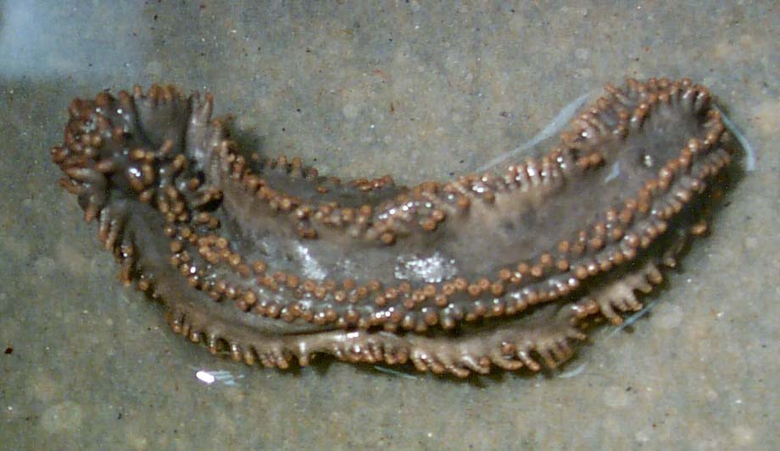
Class Holothuroidea
- Sea Cucumbers
Respiratory Structure?
Term for releasing insides?
Symmetry as adult?

Slide 4
Class Holothuroidea
- Sea Cucumbers
Respiratory Tree
Evisceration
Secondarily bilateral as adults

Slide 5
Class Asteroidea
- Sea Stars
Path of Water
Flow:
Madreporite ->stone canal ->ring canal->
radial canals->ambulacral groove->lateral
/transverse canals-> tube feet/ampullae
Surface features visible in some sea stars but more so in Echinoids:
Pedicellariae - for cleaning the surface
Papulae = dermal branchiae - for respiration

Slide 6
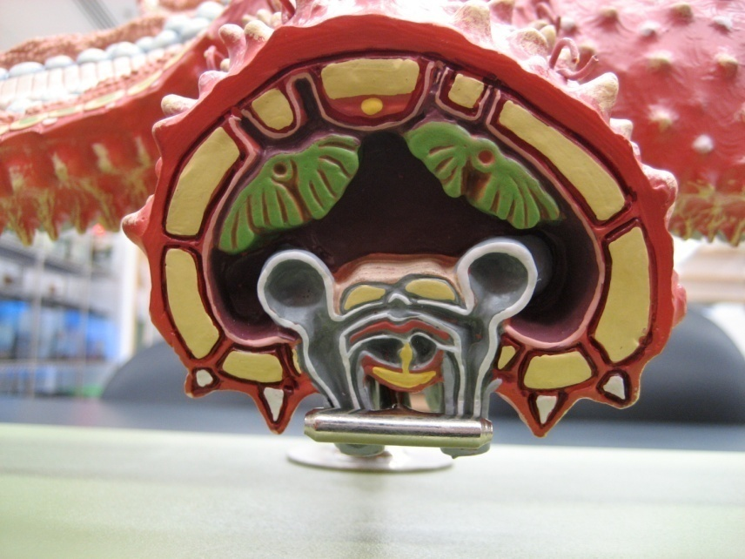
Cross Sections through Ray of a Sea Star
Pyloric Caecum
A
Gonad
Radial Canal and tube feet
B
A
Ambulacral Ridge
Ambulacral Groove
Perivisceral Coelom
Ampulla
Anus - Aboral surface
Hepatic or pyloric caecum
B
Podium
Pyloric Stomach
Sucker
Enables locomotion – but in Ophiuroidea this is replaced by a platelet, preventing tube feet being used for movement.
F
O
O
D
Cardiac Stomach - can be everted in some seastars!
Mouth – oral surface

Slide 7
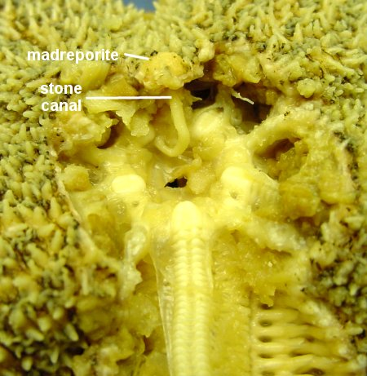
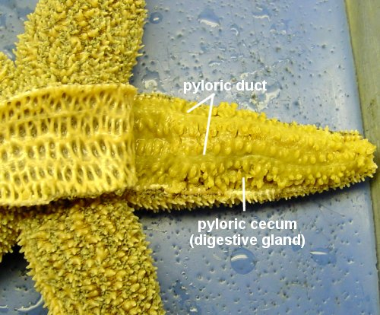
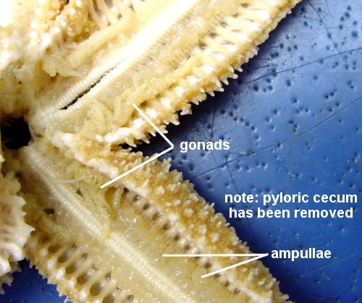
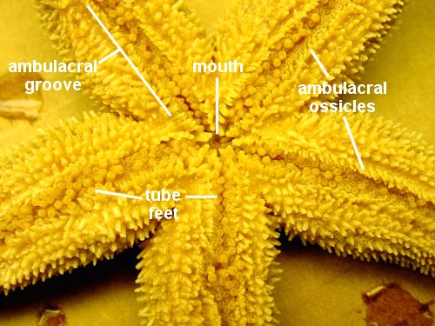
http://www.k-state.edu/organismic/echinoderms_and_protochordates.htm

Slide 8
Class Echinoidea
- Sea Urchins, Sand Dollars
What is the test is used for? What is it made of?
Aristotle’s Lantern is used for what?
Name the other surface features. Functions?

Slide 9
Class Echinoidea
- Sea Urchins, Sand Dollars
Test – Support Made up of ossicles
Aristotle’s Lantern – Feeding
Pedicellariae are for cleaning the surface
Papulae are dermal branchiae for respiration

Slide 10
Class Crinoidea
- Sea Lilies and Feather Stars
Mouth on upper surface of body
Madreporite is oral instead of aboral
Tube feet used mainly for feeding
Sounds (and are) much prettier than our specimens
would have you believe!
Stalked crinoid = Sea Lily
Feather Star
Mouth
Cirri
Cirri

Slide 11
Class Ophiuroidea
- Brittle Stars, Basket Stars
No Anus, all organs
in central disk
What is the advantage of
having an anus?
First phylum to have an anus?
What is special about a brittle
star’s tube feet?

Slide 12
Class Ophiuroidea
- Brittle Stars, Basket Stars
No Anus, all organs
in central disk
More efficient digestion
– can specialize function
Nemertina?
No sucker but a plate on end of
the podia (tube). Cannot be
used for locomotion.

